Slide 1
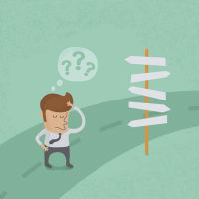
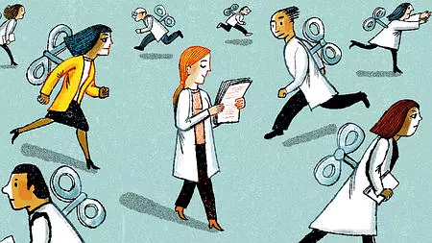
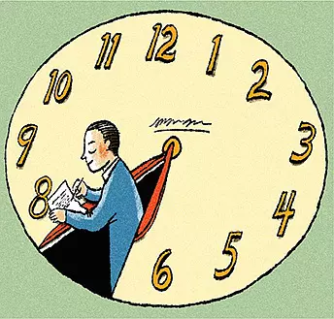
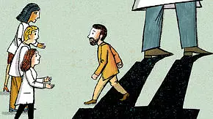
不要温和地走进静谧的良夜 Do not go gentle into that good night 王成军 2018级研究生开学典礼

Slide 2
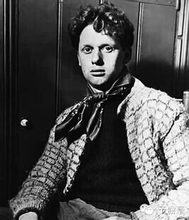
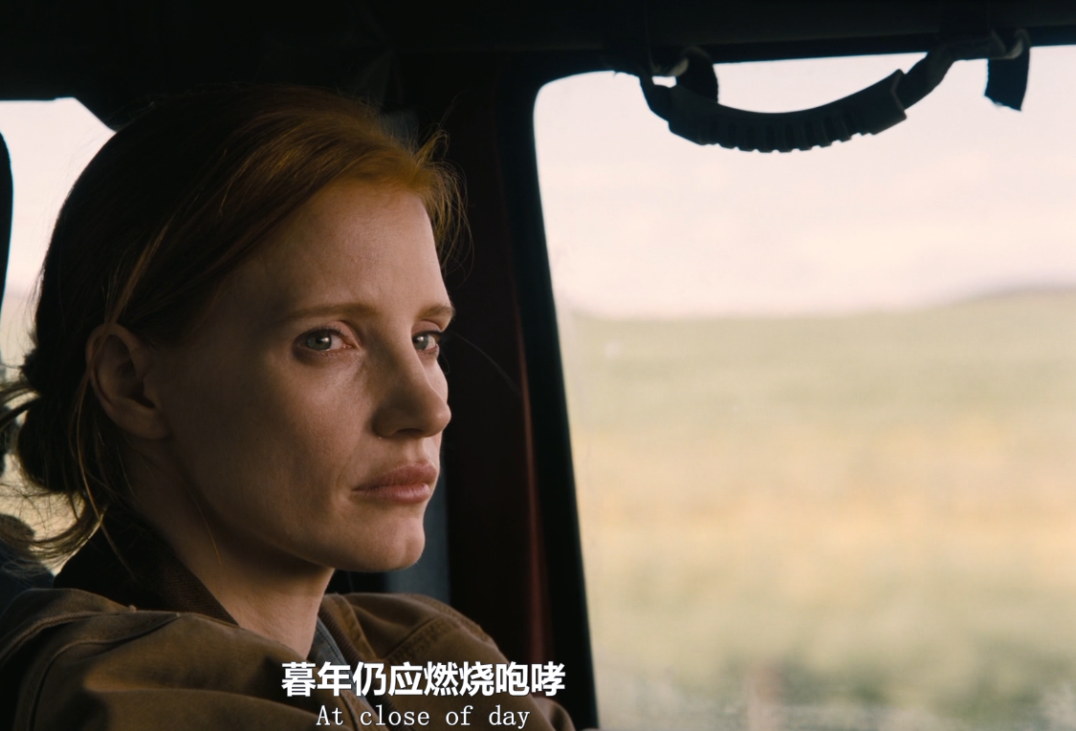
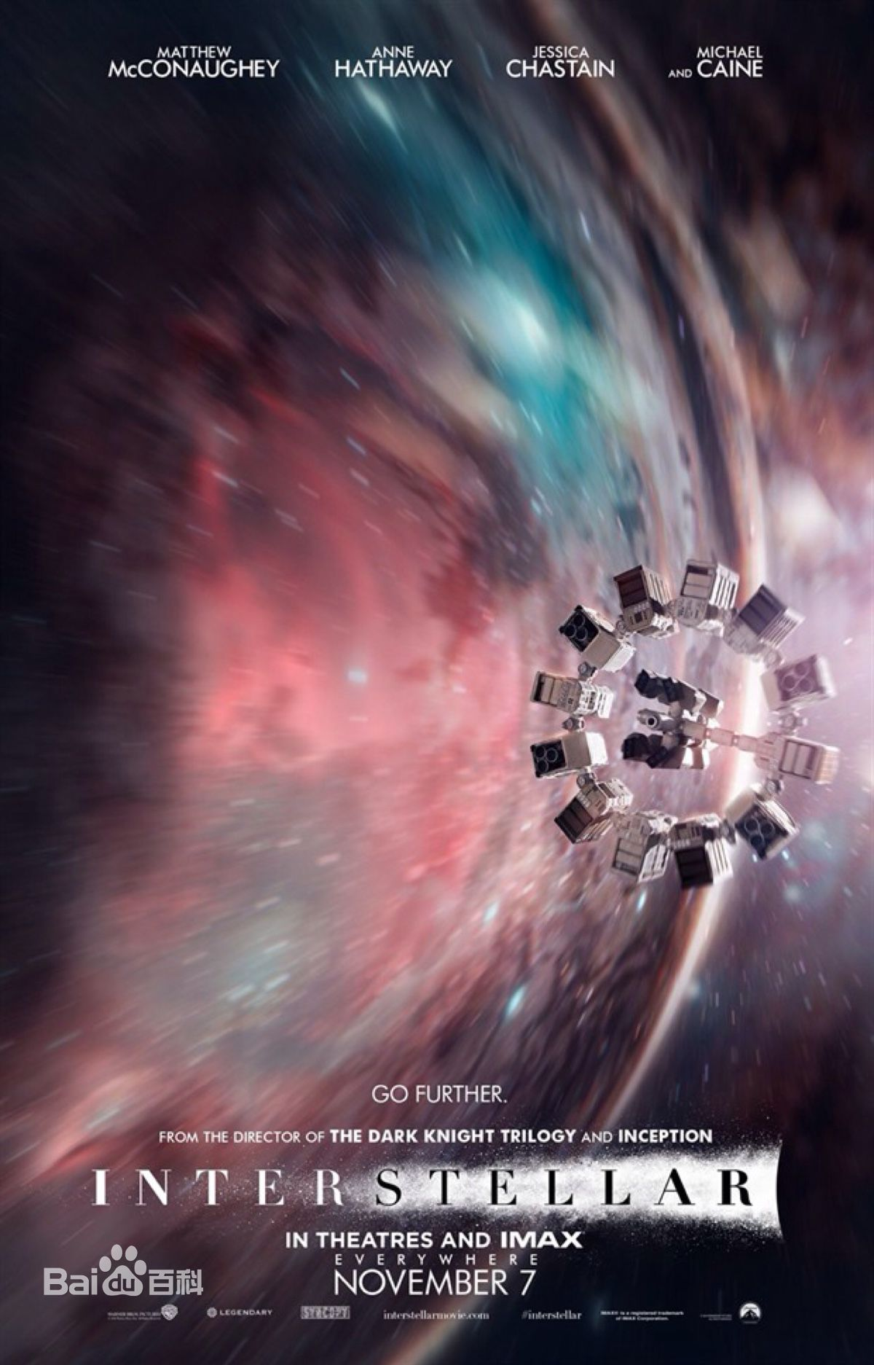
不要踏入静谧的良夜
Do not go gentle into that good night,
Old age should burn and rave at close of day;
Rage, rage against the dying of the light.
不要踏入静谧的良夜
暮年也应在黄昏中燃烧
反抗吧，在这将逝的时光里反抗吧
Dylan Thomas,
1914 – 1953

Slide 3
“Nowadays people often feel that their private lives are a series of traps.”
C. Wright Mills
https://www.nature.com/articles/d41586-018-02109-8
Notes:
After ten years of tracking adolescents’ mental health and use of smartphones, I think that such views are misguided. Most young people aged 11–19 (ages vary between studies) are doing well in the digital age. In the United States, a record 84% of students graduated from high school in 2016. Pregnancy, violence, alcohol abuse and smoking have all declined in teenagers in the past 20 years. Similar trends have been observed in other countries。
Sedgh, G., Finer, L. B., Bankole, A., Eilers, M. A. & Singh, S. J. Adolesc. Health 56, 223–230 (2015).

Slide 4
The Dilemma of Modern Society
I feared those who ban books, deprive us of information, conceal the truth, and we become a captive culture.
1984
George Orwell
I feared:
there would be no reason to ban a book, for there would be no one who wanted to read one.
those who would give us so much that we would be reduced to passivity and egoism.
the truth would be drowned in a sea of irrelevance.
we would become a trivial culture, preoccupied with some equivalent of the feelies, the orgy porgy, and the centrifugal bumblepuppy.
Brave New World
Aldous Huxley
Amusing Ourselves to Death (Neil Postman,1985)
Notes:
豢养的文化 vs 微不足道的文化

Slide 5
Smartphones are bad for some teens, not all
https://www.nature.com/articles/d41586-018-02109-8
Notes:
After ten years of tracking adolescents’ mental health and use of smartphones, I think that such views are misguided. Most young people aged 11–19 (ages vary between studies) are doing well in the digital age. In the United States, a record 84% of students graduated from high school in 2016. Pregnancy, violence, alcohol abuse and smoking have all declined in teenagers in the past 20 years. Similar trends have been observed in other countries。
Sedgh, G., Finer, L. B., Bankole, A., Eilers, M. A. & Singh, S. J. Adolesc. Health 56, 223–230 (2015).

Slide 6
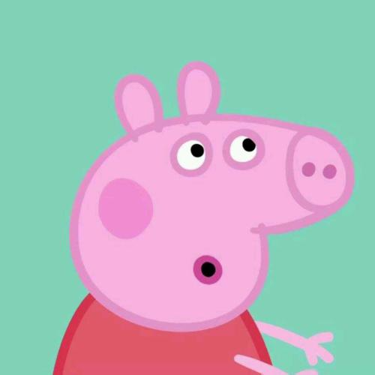
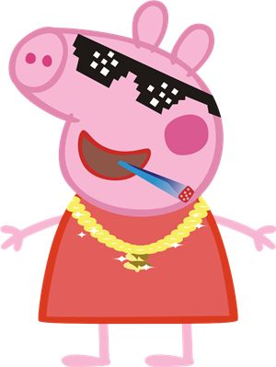
逃跑是可耻的但有用？！
沉迷流行文化?
嫁一个程序员？
社会人

Slide 7
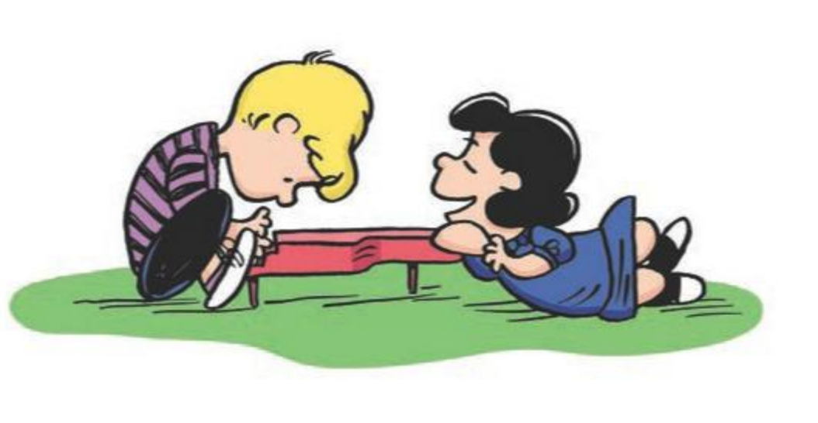
Be Sharp!
BE
SHARP

Slide 8
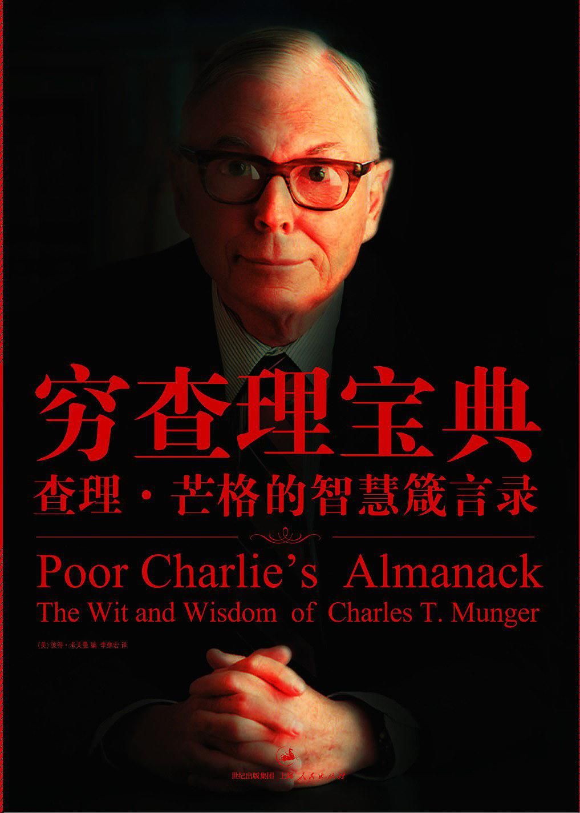
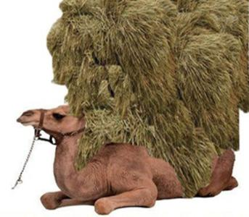
穷查理宝典
也许所有教育最有价值的结果是：
当你不得不完成一件事情的时候，不管你是否喜欢它，你都有能力去完成这项必须的任务。
这是每个人应该学的第一课
然而无论一个人多早接受教育，这可能是他彻底学到的最后一课。
Notes:
做人要诚实，不是因为它是优秀的道德品质，而是那样做能给你免去记忆谎言的麻烦，释放更多脑力去你该做的事情。
给你带来麻烦的不是坏主意，而是好主意。
如果一件事情是个坏主意，你不会做过头。
但如果一件事情是个好主意，蕴含着重要的真理，那你就没办法忽略了。然后你就很容易做过头。

Slide 9
SMART 原则
具体、可衡量、面向行动、现实、有时限。
把规划从模糊的目标转变为具体目标,
并有时间表和行动计划
Julie Gould (2017) Career development: A plan for action. Nature 548 , 489–490 4(24 August 2017) doi:10.1038/nj7668-489a 10.1038 / nj7668-489a

Slide 10
Be Smart!
1. Create specific, clear goals that are based around these questions:
What do I want to accomplish?
Why is this goal important?
Who is involved?
Where do I need to be?
Which resources or limits are involved?
If, for example, you want to improve your writing skills, you might consider what you will do, who can help you, when you can do what's required and what improved writing skills would look like.
大愿望术
如果你知道往哪里走，
全世界都会给你让步！

Slide 11
Be Smart!
2. Establish concrete criteria for measuring your progress.
Write down each step you will need to take
Write down how you will know when you reach that goal.
3. Make sure your goals are action-oriented.
Ask for the resources you need
mark check-in dates for the goals in your diary.
Each goal should have a series of smaller sub-goals that you can tick off as you complete them.

Slide 12
Be Smart!
4. Create realistic goals that fit into your research schedule.
You MUST truly believe that you can accomplish them.
5. Give each goal a time frame.
Sense of urgency.

Slide 13
工作日记，年度效率手册
月份页面：长期规划和行程安排
每天的页面：每天的工作
不要长篇大论，简单扼要
放在电脑包里，随身携带，不能太大太重。
记录做了什么
记录计划做什么
记下来灵感想法。
坚持每天使用，常常查阅。
妥善保存、见证成长。

Slide 14
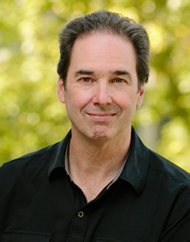
The 1-hour workday
I wake up early, make an espresso, and write
until I'm spent
I plan my early morning writing the night before.
It is in my calendar and on my to-do list
with details about which paper and section I will be working on.
Jeffrey J. McDonnell
Jeffrey J. McDonnell. (2016) The 1-hour workday. Science 353: 6300, pp. 718, DOI: 10.1126/science.353.6300.718

Slide 15
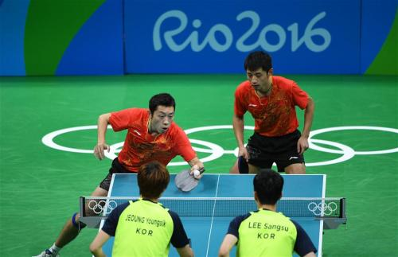
The 1-hour workday
Many days, “writing” means editing and revising the work of others.
thinking of it as a game of table tennis.
My goal is to return the serve—when done quickly, this greatly improves the game.
It is never too late!
Jeffrey J. McDonnell
Jeffrey J. McDonnell. (2016) The 1-hour workday. Science 353: 6300, pp. 718, DOI: 10.1126/science.353.6300.718

Slide 16
Daniel Tiger's Neighborhood
When We Do Something New, Let‘s Talk About What We’ll Do!

Slide 17
主动思考和尝试
生命应该有一种冲动而朴实的目的和快感，每一个人都应当找到属于自己的道路，可以超越时代和社会。
主动的思考和尝试能够让自己把握住节奏，更坚韧，更能体会到科研的乐趣。
要展现你的领导力，就要主动思考回答困扰整个团队的问题
不断思考，千万不要等着别人来推动自己，那样就在智力上成了别人的附庸

Slide 18
Do not go gentle into that good night
不要温和地走进2018，
不要让黄昏时的暮气消解了激情，
不要在习惯中走入消亡，
不要安于琐碎的幸福，
不要陷于精致的计算。
“无论时代的潮流或社会的风尚如何，我们都可以凭着自己高贵的品质，选择属于自己的正确的道路。”
不要温和地走进2015 | 刺猬公社新年献词

Slide 19
Thank you for your attention!
END
Choose the right pace for your race.
Enjoy your time!

